Slide 1

Capstone Project: Battle of Neighbourhoods
by Rohit Dutta

Slide 2
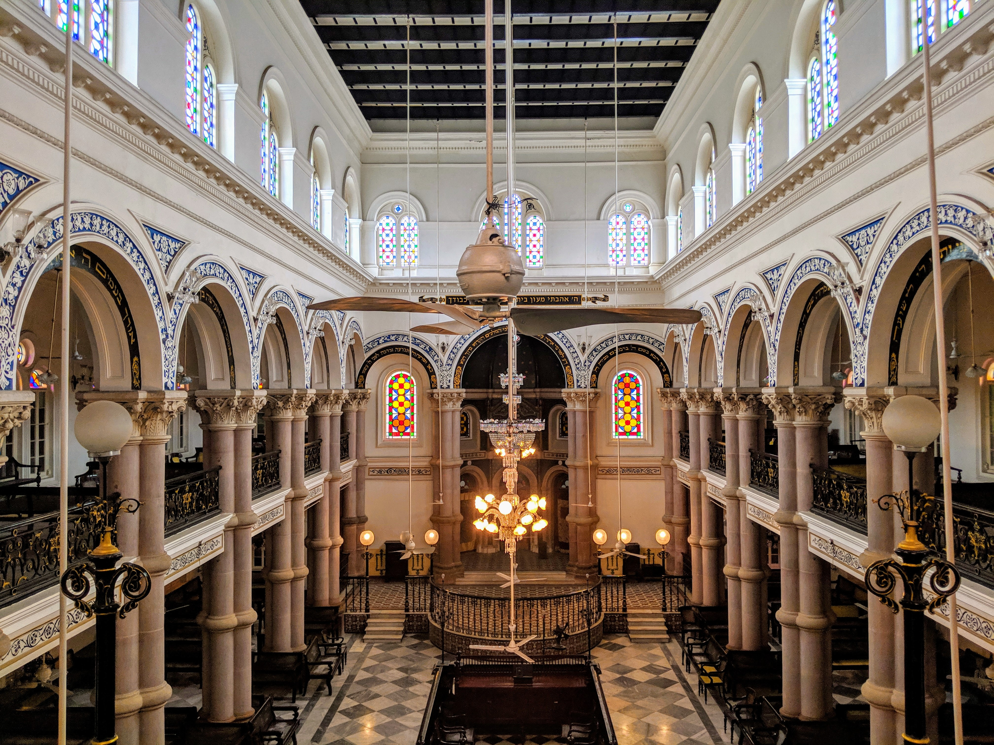
Introduction
In this project we will try to find an optimal location for a restaurant. Specifically, this report will be targeted to stakeholders interested in opening an restaurant in Kolkata, West Bengal, India.
Since there are lots of restaurants in Kolkata we will try to detect locations that are not already crowded with restaurants. We are also particularly interested in areas with no restaurants in vicinity. We would also prefer locations as close to city centre as possible, assuming that first two conditions are met.
We will use our data science powers to generate a few most promising neighbourhoods based on this criteria. Advantages of each area will then be clearly expressed so that best possible final location can be chosen by stakeholders.

Slide 3
Data Acquisition and Cleaning
Based on definition of our problem, factors that will influence our decission are:
number of existing restaurants in the neighborhood (any type of restaurant)
distance to restaurants in the neighborhood, if any
distance of neighborhood from city center
We decided to use regularly spaced grid of locations, centered around city center, to define our neighborhoods.
Following data sources will be needed to extract/generate the required information:
centers of candidate areas will be generated algorithmically and approximate addresses of centers of those areas will be obtained using geopy reverse geocoding
number of restaurants and their type and location in every neighborhood will be obtained using Foursquare API
coordinate of Kolkata center will be obtained using geopy geocoding of well known Kolkata location (Rabindra Sadan/ Park Street/ Esplanade)

Slide 4
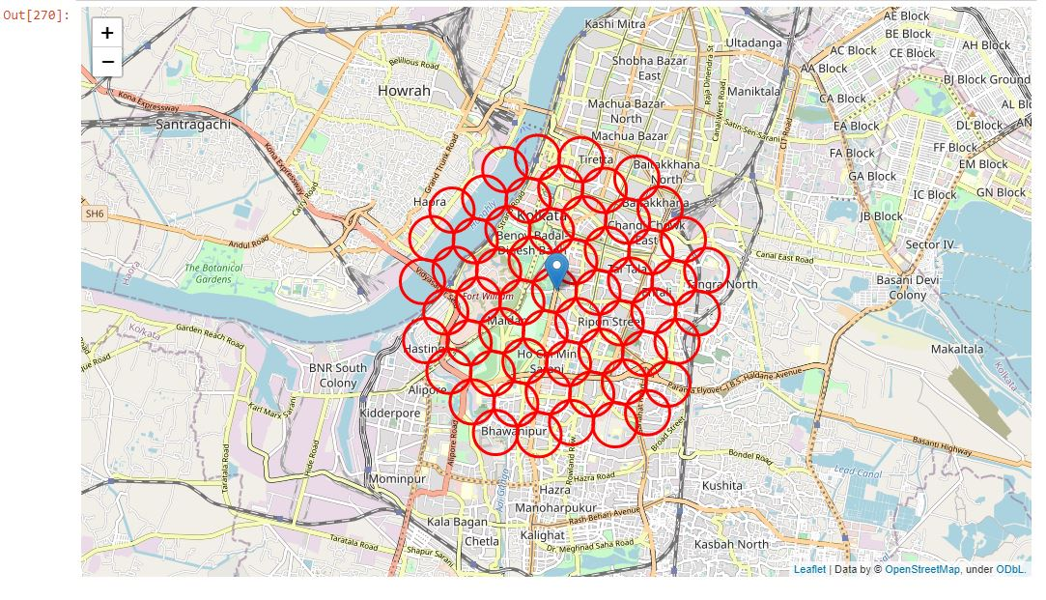
Visualization
Map of Park Street with 58 randomly generated neighbourhoods.

Slide 5
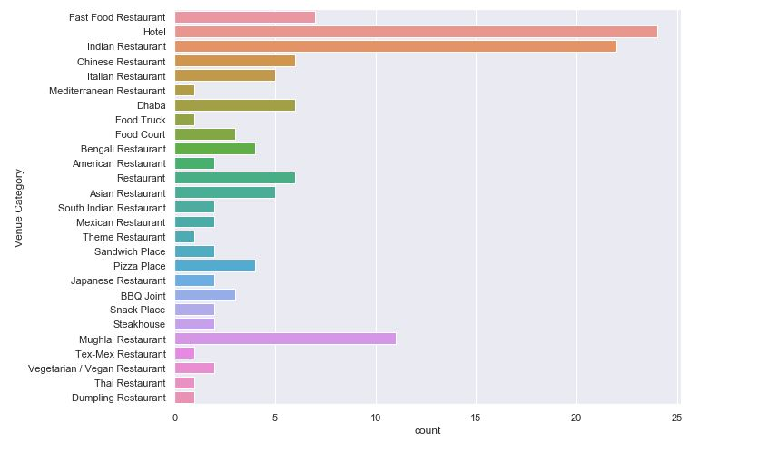
Total number of restaurants within 8km radius of Park Street, Kolkata

Slide 6
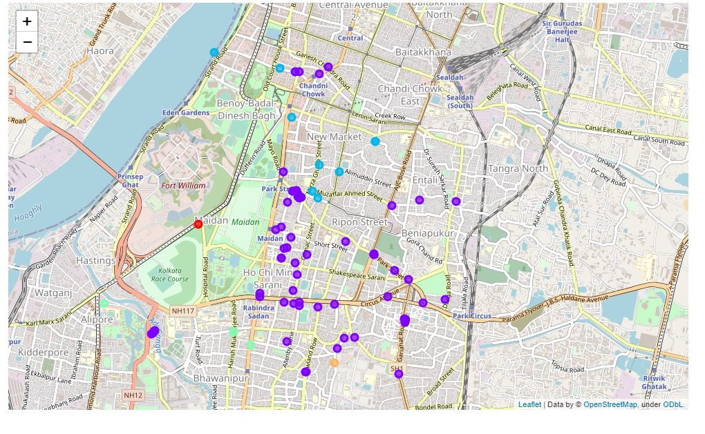
Visualizing the Clusters

Slide 7
Result & Discussion
Therefore, from whatever limited data available, we could successfully identify 26 zones where the number of restaurants were less than 10 in their vicinity. Most of them had restaurant count even less than 5 in 400 m surroundings. What we observe is that Kolkata is comparatively less restaurant density. More data could have helped us to understand our regions in a much better manner.
Those location candidates were then clustered to create zones of interest which contain greatest number of location candidates. It was found that cluster 2 has 80% of the venues grouped together. Further observations reveal that 'Italian Restaurant', 'Bengali Restaurant', 'Asian Restaurant', 'Indian Restaurant', 'Chinese Restaurant', 'Mughlai Restaurant', 'South Indian Restaurant' are the most common types of restaurants. Hence the stakeholders can try setting up restaurants of different cultures other than the already present common ones.

Slide 8
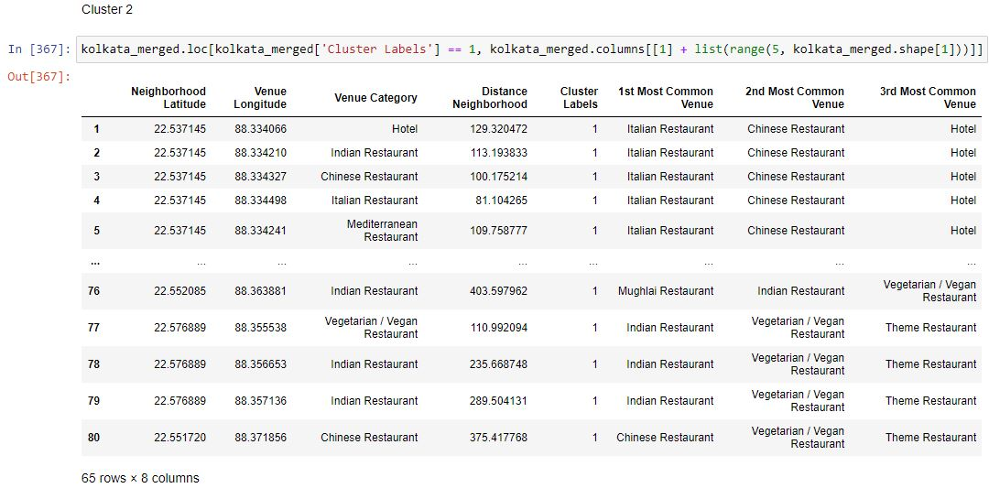

Slide 9
Conclusion
Purpose of this project was to identify Kolkata areas close to center with low number of restaurants in order to aid stakeholders in narrowing down the search for optimal location for a new restaurant. By calculating restaurant density distribution from Foursquare data, we have first identified general addresses that justify further analysis and then generated extensive collection of locations which satisfy some basic requirements regarding existing nearby restaurants. Clustering of those locations was then performed in order to create major zones of interest (containing greatest number of potential locations) and addresses of those zone centers were created to be used as starting points for final exploration by stakeholders.
Final decision on optimal restaurant location will be made by stakeholders based on specific characteristics of neighborhoods and locations in every recommended zone, taking into consideration additional factors like attractiveness of each location (proximity to park or water), levels of noise / proximity to major roads, real estate availability, prices, social and economic dynamics of every neighborhood etc.

